Slide 1

11th BRICS Academic Forum – Brasilia
Energy and Development Strategy
Professor Leonid Grigoryev
Chief Advisor to the Head of Analytical Center
under the Government of the Russian Federation
www.leonidgrigoryev.com
Brasilia, IPEA, 12 September - 2019

Slide 2
Agenda: Long-term Growth and Catching up
Forecasts for Growth and Energy Consumption – 2040
Inequality in Growth – cluster approach
Paris agreement on Climate and reality
SDG and Paris = Growth, Catching up and Society
Poor have their rights for Energy
Technological changes, Digital and Energy
Emission by “production” V by “consumption”
Future integration of Energy and Climate policies for SD

Slide 4

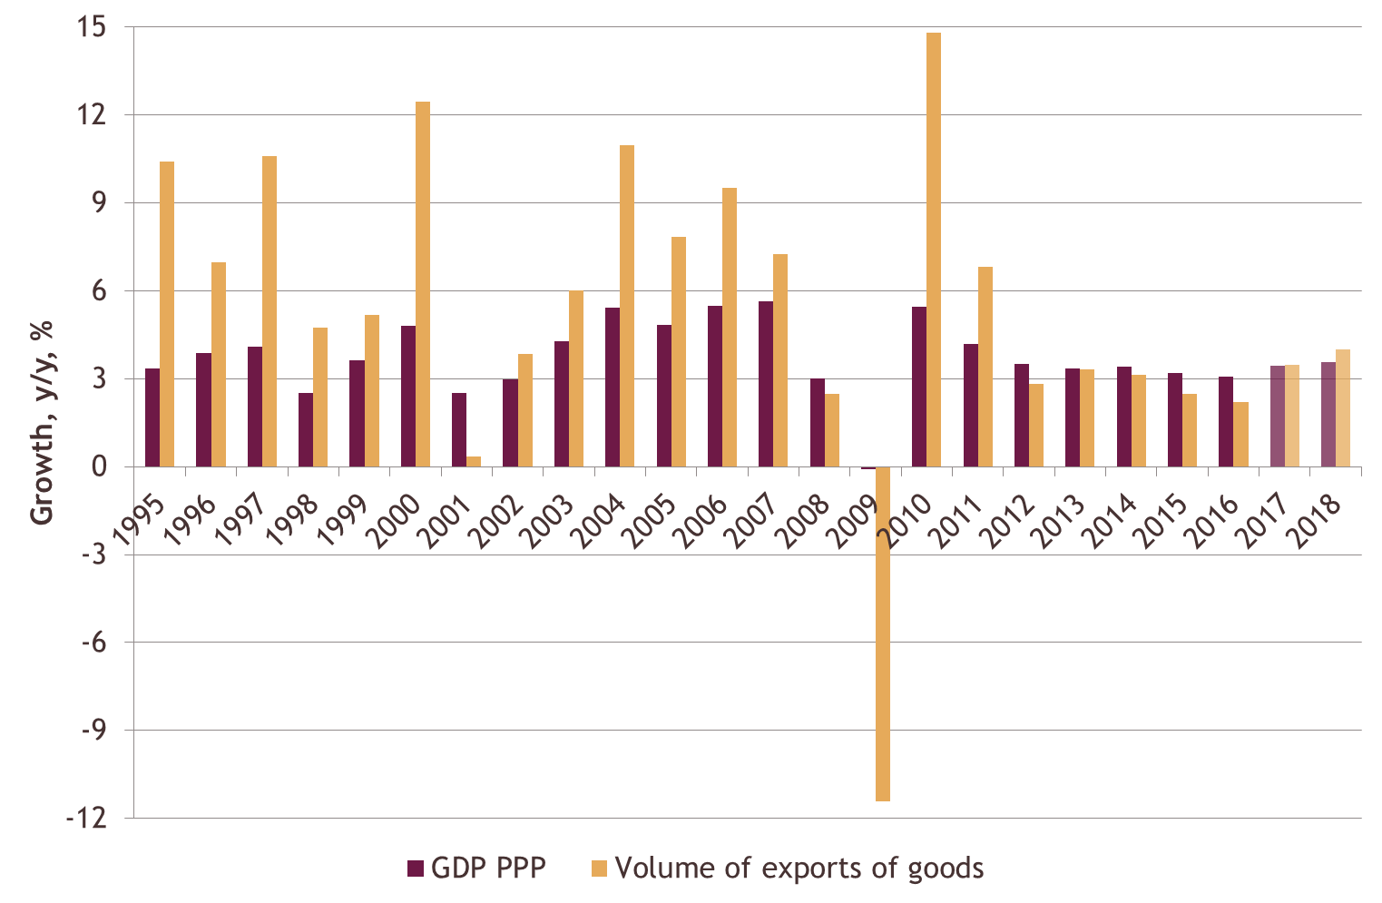
World GDP and Trade Growth rate, %, 1995‑2018
4
Source: IMF, WEO April 2017 Edition

Slide 5
Carbon Dioxide Emissions, 1985-2017
5
Source: BP Stat. Review 2017

Slide 6
OECD countries (2015): consumption-based emissions are much higher than production-based
Country | Production-based emissions |  | Consumption-based emissions |  | Net exports of emissions
 | Mt | % of world | Mt | % of world | Mt | % of national emissions
OECD, total | 12 204.2 | 37.8% | 13 781.2 | 42.7% | -1 581.1 | -13.0%
Canada | 556.4 | 1.7% | 547.9 | 1.7% | 9.8 | 1.8%
France | 311.9 | 1.0% | 445.0 | 1.4% | -131.6 | -42.2%
Germany | 765.7 | 2.4% | 853.4 | 2.6% | -84.6 | -11.0%
Italy | 346.8 | 1.1% | 423.0 | 1.3% | -75.8 | -21.9%
Japan | 1 202.3 | 3.7% | 1 361.0 | 4.2% | -158.2 | -13.2%
Spain | 263.3 | 0.8% | 293.8 | 0.9% | -32.1 | -12.2%
Sweden | 43.8 | 0.1% | 70.2 | 0.2% | -26.2 | -59.9%
United Kingdom | 430.8 | 1.3% | 575.8 | 1.8% | -142.5 | -33.1%
United States | 5 020.0 | 15.6% | 5 794.5 | 18.0% | -785.3 | -15.6%
Source: OECD
In details: Makarov I. A., Sokolova A. (2017) Carbon emissions embodied in Russia's trade: implications for climate policy
// Review of European and Russian Affairs. 11(2).

Slide 7
BRICS countries (2015): production-based emissions are much higher than consumption-based; bln ton, % of emission.
Country | Production-based emissions |  | Consumption-based emissions |  | Net exports of emissions
 | Mt | % of world | Mt | % of world | Mt | % of national emissions
BRICS, total | 13 687.5 | 42.4% | 11 853.1 | 36.7% | 1 841.0 | 13.5%
Brazil | 461.2 | 1.4% | 475.4 | 1.5% | -13.3 | -2.9%
China | 9 280.8 | 28.8% | 7 977.9 | 24.7% | 1 308.8 | 14.1%
India | 2 043.4 | 6.3% | 1 918.8 | 5.9% | 124.2 | 6.1%
Russia | 1 487.6 | 4.6% | 1 167.5 | 3.6% | 320.7 | 21.6%
South Africa | 414.5 | 1.3% | 313.5 | 1.0% | 100.6 | 24.3%
Source: OECD
In details: Makarov I. A., Sokolova A. (2017) Carbon emissions embodied in Russia's trade: implications for climate policy
// Review of European and Russian Affairs. 11(2).

Slide 8
CO₂e emissions concentration shares in 2013 (%)
Elasticity | Top 1% | Top 5% | Top 10% | Middle 40% | Bottom 50% | Bottom 10%
0.9 | 13.8 | 31.5 | 45.2 | 41.8 | 13.0 | 1.2
0.7 | 9.9 | 26.6 | 40.0 | 44.8 | 15.3 | 1.5
1.1 | 19.0 | 38.0 | 51.3 | 38.0 | 10.7 | 0.9
Source: Chancel and Piketty (2015)

Slide 9
Distribution of CO2 emissions in China by income group in 2002
Grouping* | Tons of CO₂ per capita | Share of population, % | Share of emissions, %
10th decile | 6.3 | 7.6 | 28.3
Top 40% | 2.5 | 35.6 | 51.8
Bottom 40% | 0.7 | 44.0 | 18.3
1st decile | 0.2 | 12.8 | 1.6
* In the source "decile" means not one tenth of the population, but a group of people with significantly different incomes, whose number is close to one tenth
Source: Authors’ calculations based on the data from World Development Indicators; Li, Wang (2010).

Slide 11
