Slide 1
IFI Governance and The Challenge of the SDGs
Daniel Bradlow
SARCHI Professor of International Development Law and African Economic Relations.
International Development Law Unit, Centre for Human Rights
University of Pretoria
Email: danny.bradlow@up.ac.za
“Globalization 4.0, changing world order and future of Global Economic Governance”
Russian Presidential Academy of National Economy and Public Administration (RAPENA)
Moscow, 3-4 October 2019

Slide 2
Overview
3 Key points:
Good reasons to be sceptical about SDGs but they may have an (unintended??) profound impact at national and international level
Focus is on international level and particularly IFIs
Impact of SDGs ➔ new ways of “doing business”
SDGs can have significant impact on sovereignty
Plan:
Talk about SDGs in general
Talk about implications for operations and governance of IFIs
Talk about implications for sovereignty and challenges

Slide 3
SDGs v. MDGs
SDGs
MDGs
Participatory process
Applicable to all states
17 goals,169 targets,232 indicators
People (hunger, health, education, gender, inequality),
Planet (water, energy, consumption, climate, sea, land)
Peace (justice, institutions),
Prosperity(work, growth,industry innovation, infrastructure) Partnership (cities, communities, international partnerships)
Top=down, technocratic process
Only applies to developing countries
8 goals and 21 targets
end extreme poverty,
achieve universal primary education,
promote gender equity,
reduce child mortality,
improve maternal health,
combat HIV, malaria,
ensure sustainability,
promote global partnerships

Slide 4
Scepticism about the SDGs? (Slide 1)
Reasons to be sceptical about SDGs:
Over-ambitious (solve all problems in world in 15 years),
Over-complex– hard to prioritize
Under-funded (funding gap is about $2,5 trillion/year)
We will not achieve them by 2030
Most countries are lagging particularly in efforts to improve sanitation, nutrition, basic medical care, shelter and water,
No country currently on track to meet all the goals.
Recently the Social Progress Imperative, a U.S.-based nonprofit, said the goals were unlikely to be reached until 2073.

Slide 5
Scepticism about the SDGs? (Slide 2)
“SDG impact multipliers”:
Climate change
ESG and BHR developments in investment and economy
Growing attention to inequality and economic exclusion
SDGs and “multipliers” ➔
Affecting demands and expectations of citizens
Benchmarks for measuring performance – govt, corps, IOs
Debates about:
Appropriate role of state in economy
Purpose and responsibilities of companies,

Slide 6
Implications for Global Governance
International Economic Forums (G20, OECD, G24) ➔
Financial inclusion
Illicit flows
FSB task force on climate related financial disclosures
OECD responsible business practices– financial sector
States ➔
Modern slavery acts (UK, Australia)
Increased disclosures on conditions in supply chain (France, Germany)
Network on Greening the Financial System
Corporations➔
UNPRI– Dutch CB
UNGPs – HR policies of companies
ESG – investors, securities regulators

Slide 7
Implications for IFIs
IFI responding (implicitly??) to SDGs:
IMF ➔ increased attention to community level impacts, gender, inequality
MDBs– revising ES frameworks – focus on due diligence and impact assessments
IFI governance implications:
Focus on impacts ➔opens Pandora’s box
Need channels of communication with non-state actors
Issue of tech assistance/capacity building
Issue of accountability

Slide 8
SDGs and Sovereignty
Even though not legally binding, they raise issues around sovereignty:
IFIs themselves are accountable and so need to ensure operations meet standards
➔ greater intrusion into member states
SDGs provide international framework for holding governments accountable?
Both in terms of policies and impacts
Related to but more specific than human rights
Issues of MAR (Art 2 UNCESCR== MAR for progressive realization of ESCR)

Slide 9
Challenges
Growing backlash against “ethos of SDGs” :
More insistence on sovereignty but this is unsustainable.
Growing inter-connections and reduced ability of states to solve problems on their own are increasing role of IOs in general
Implications for IFIs
Member state frustration,
Competition among IFIs➔ convergence/divergence ???
Changing role but unreformed governance
Focus is on unaddressed issue: IO—non-state actor relations

Slide 10
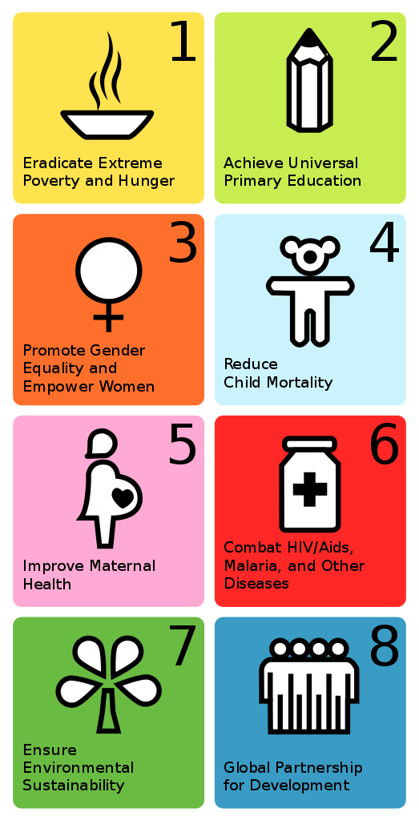

Slide 11
